Slide 1
Project Title
“Online Learning Platform using AWS Services”
Presented by: Subhashini Rajamani & Abarna
Course and Batch : AWS ( July,2025 – 11:30AM to 01:00PM )

Slide 2
PROJECT OVERVIEW
This project is a cloud-based Online Learning Platform built using AWS services.
Students can enroll, browse courses, watch videos, and track their progress online.
The platform uses a serverless architecture with S3, Lambda, API Gateway, DynamoDB, and SES.
User enrollment details and course progress are stored and updated in DynamoDB in real-time.
The system ensures scalability, low cost, and zero server maintenance using AWS cloud tools.

Slide 3
PROBLEM STATEMENT
Traditional e-learning platforms require costly servers and manual maintenance, which increases operational cost.
Many small institutes or individuals cannot afford scalable cloud infrastructure for hosting online courses.
Users face slow performance and downtime during high traffic, due to limited server capacity.
Storing and managing user enrollment and progress data securely becomes complex without automation.
Hence, a serverless architecture using AWS was chosen to solve these issues efficiently and at low cost.

Slide 4
OBJECTIVE / GOALS
To develop a cost-effective and scalable online learning platform using AWS Serverless services.
To enable users to enroll in courses easily through a simple web interface.
To store user data securely (Name, Email, CourseID, Progress, etc.) in Amazon DynamoDB.
To host frontend content and videos in Amazon S3, ensuring high availability and low latency.
To track user progress dynamically through backend Lambda functions and update it in real-time.
To reduce infrastructure management by using serverless components like AWS Lambda and API Gateway. To demonstrate the end-to-end integration of multiple AWS services in a single project.

Slide 5
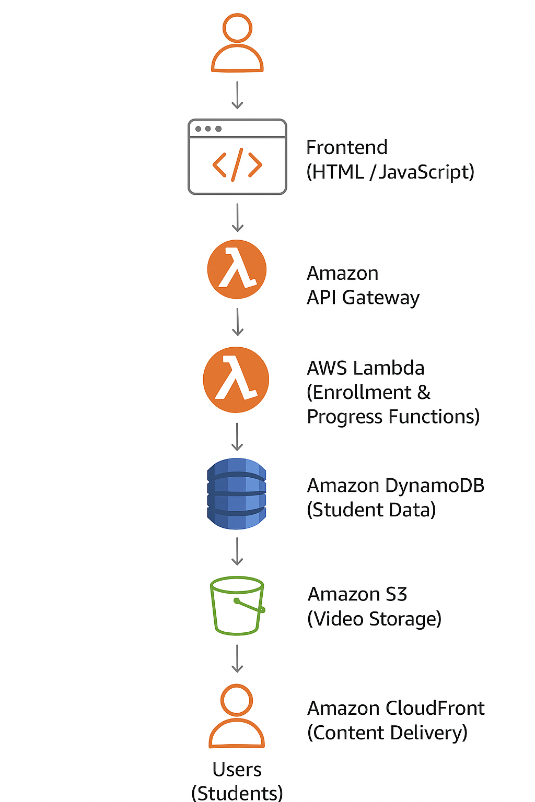
ARCHITECTURE DIAGRAM

Slide 6
Architecture Flow
User interacts with frontend hosted on S3.
API requests are handled by API Gateway.
AWS Lambda executes backend logic.
Data is stored in DynamoDB.
Videos are delivered via S3 and CloudFront.
IAM manages secure communication between services.

Slide 7
AWS Services Used
AWS IAM (Identity and Access Management) - Manages secure access permissions between AWS services (Lambda, DynamoDB, SES).
AWS Lambda – Runs backend logic for enrollment and progress update — fully serverless.
Amazon API Gateway - Exposes REST API endpoints to connect frontend with backend.
Amazon DynamoDB - NoSQL database to store user details, courses, and progress securely.
Amazon S3 - Hosts website frontend and stores learning videos or images.
Amazon CloudWatch - Monitors Lambda executions and stores application logs.
Amazon CloudFront - Distributes the website globally with faster content delivery and HTTPS support.

Slide 8
IMPLEMENTATION STEPS BELOW

Slide 9
Step 1 : Create IAM Role for Lambda
AWS Console → IAM → Roles → Create role → Choose Trusted entity = AWS Service. Service = Lambda
Attach Permissions: AmazonS3FullAccess , AmazonSESFullAccess, AWSLambda_FullAccess, CloudWatchLogsFullAccess, AmazonDynamoDBFullAccess, CloudFrontFullAccess
Enter Role name (eg; LambdaStudentRole ). Click on “ Create Role “.
Inline policy for SES permissions: (Permissions → Create inline policy)

Slide 10
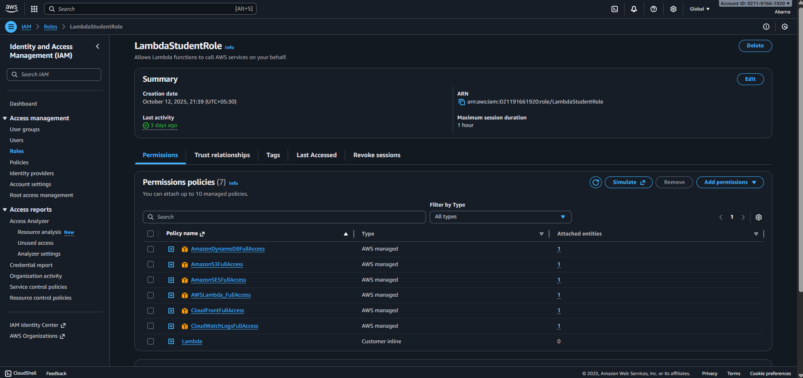

Slide 11
Step 2: Create DynamoDB Table
AWS Console → DynamoDB → Create table
Table name: LearningPlatformEnrollments
Partition key: Email (String)
Keep sort key empty
Choose On-Demand capacity mode
Click Create Table
This table will store user details like:
→ Name, Email, CourseID, Qualification, Location, Progress, Status

Slide 12
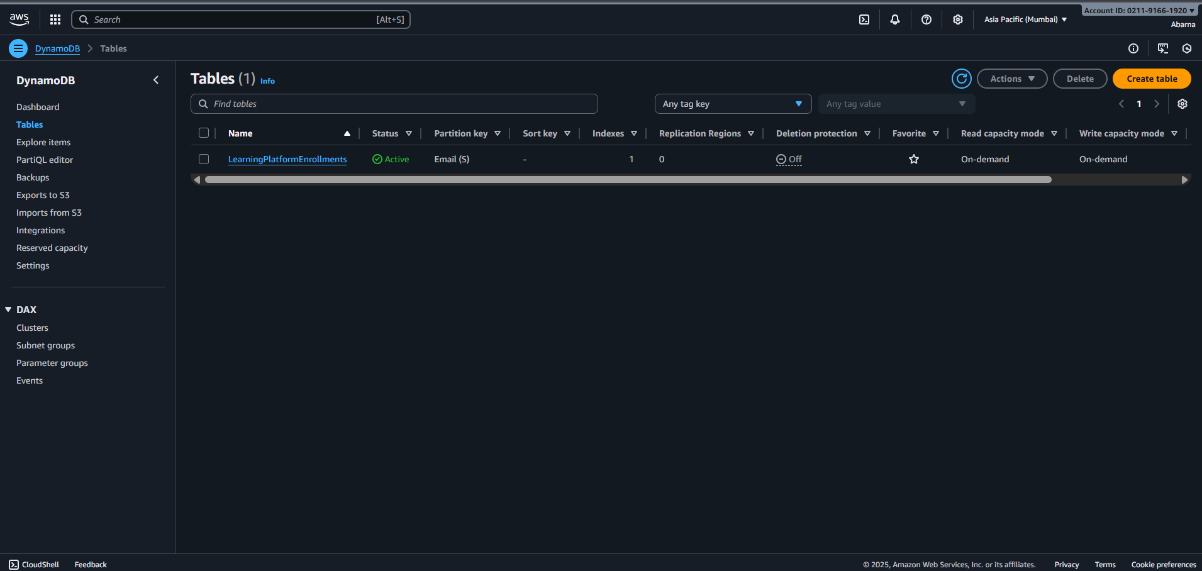

Slide 13
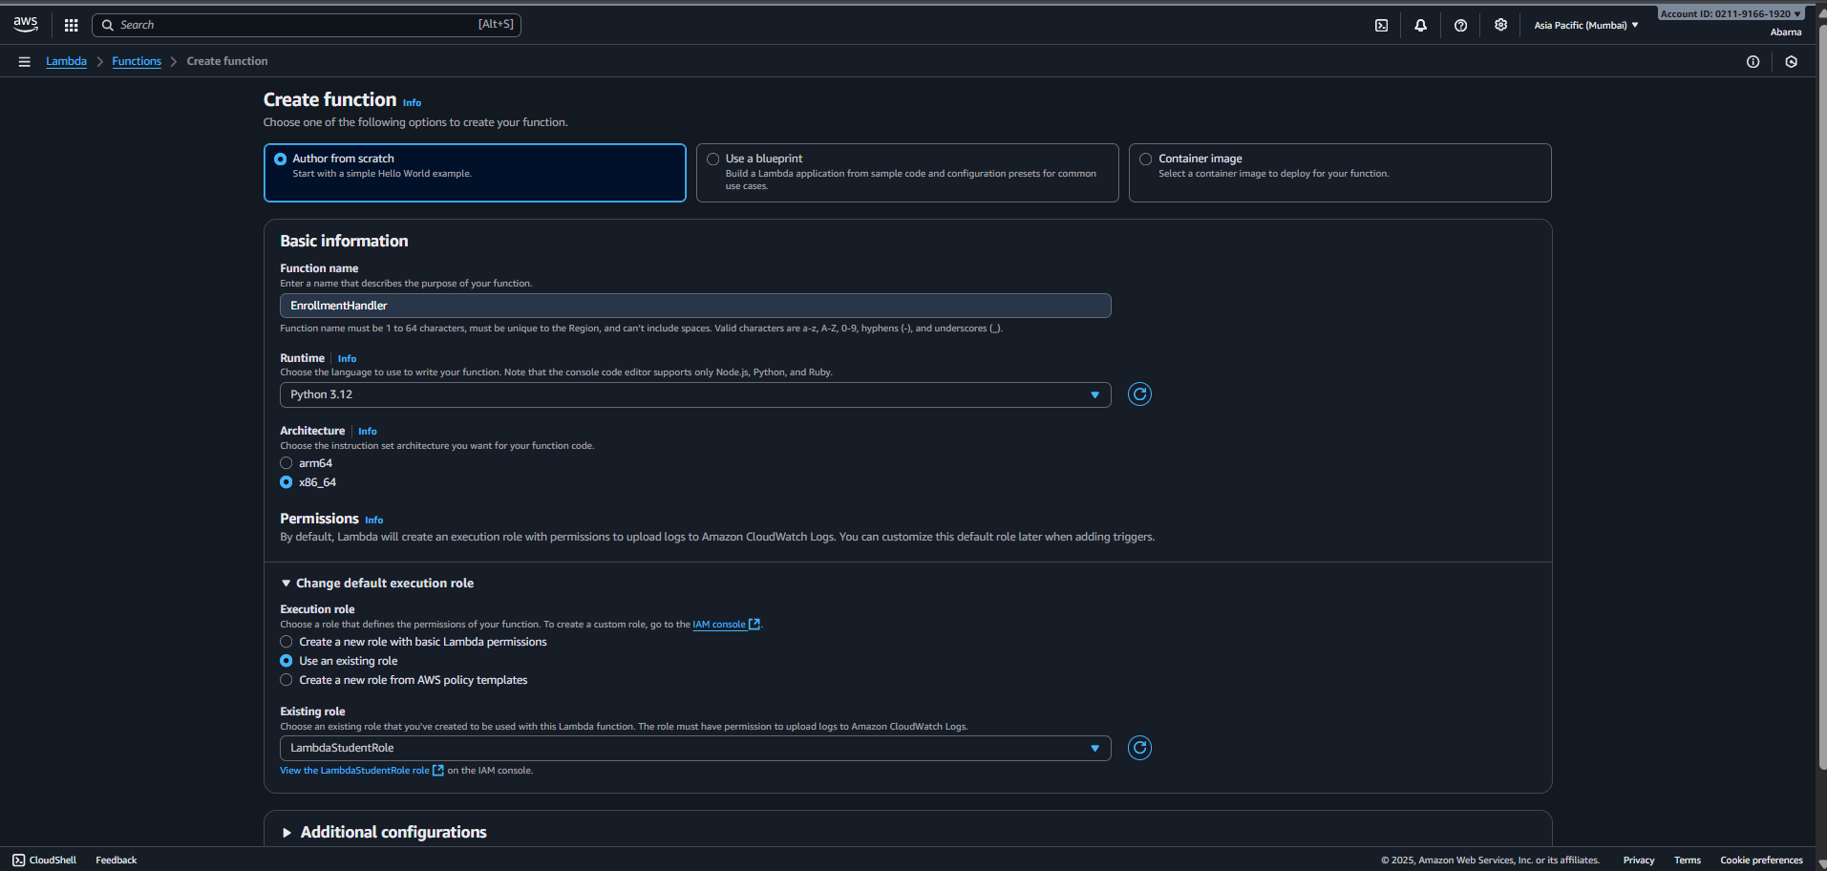
Step 3: Create Lambda Function ( Backend ) You will create two Lambda functions:
Enrollment Lambda
AWS Console → Lambda-→ Create Function (Function Name : EnrollmentHandler )
Enter name and select Runtime ( Python 3.12 )
In Change default execution role → Use an Existing role → Select created IAM role (LambdaStudentRole )and create a function.

Slide 14
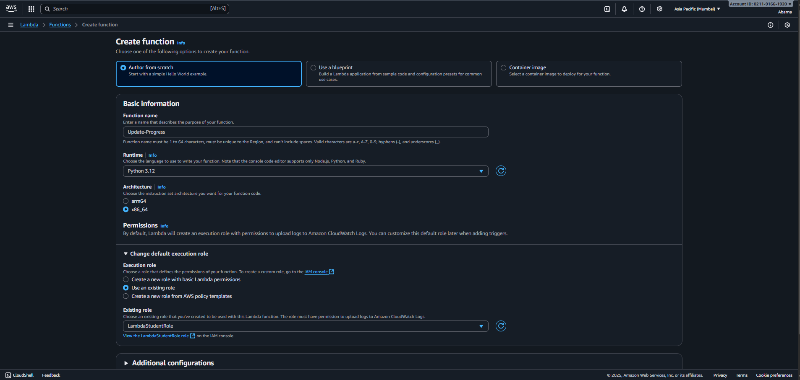
( b ): update-progress Lambda
AWS Console → Lambda-→ Create Function (Function Name : update-progress )
Enter name and select Runtime ( Python 3.12 )
In Change default execution role → Use an Existing role → Select created IAM role ( LambdaStudentRole)and create a function.

Slide 15
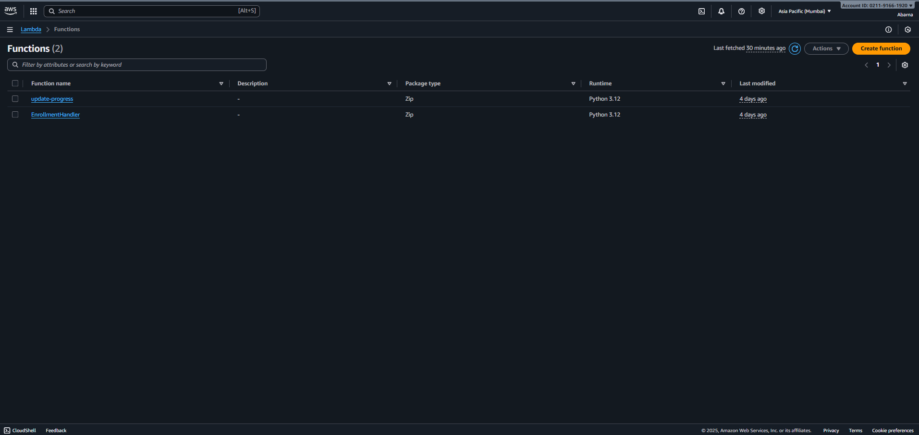
Deploy both functions and test using the Test tab or Postman. Refer Codes for Lamda Function : https://github.com/Abarna0504/Project-codes---Online-Learning-Platform.git [Enroll ( Lambda ).txt , Update-progress (Lambda ).txt ]

Slide 16
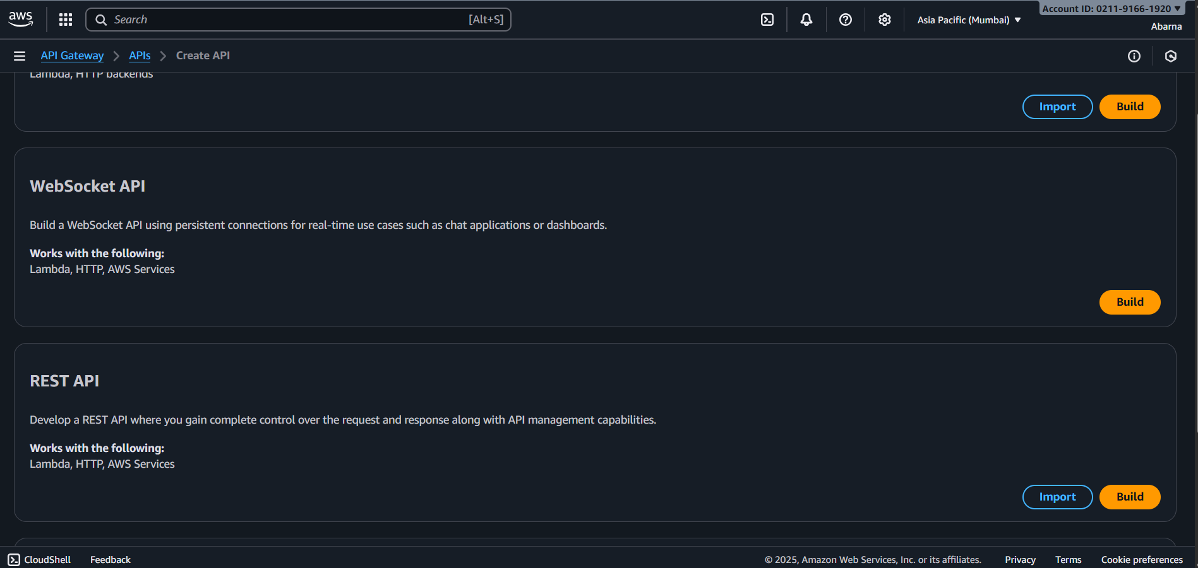
Step 4 : API Gateway (HTTP API) —connect frontend to Lambda
AWS Colsole → API Gateway → Create API → REST API → Build
API Name : LearningPlatformAPI

Slide 17
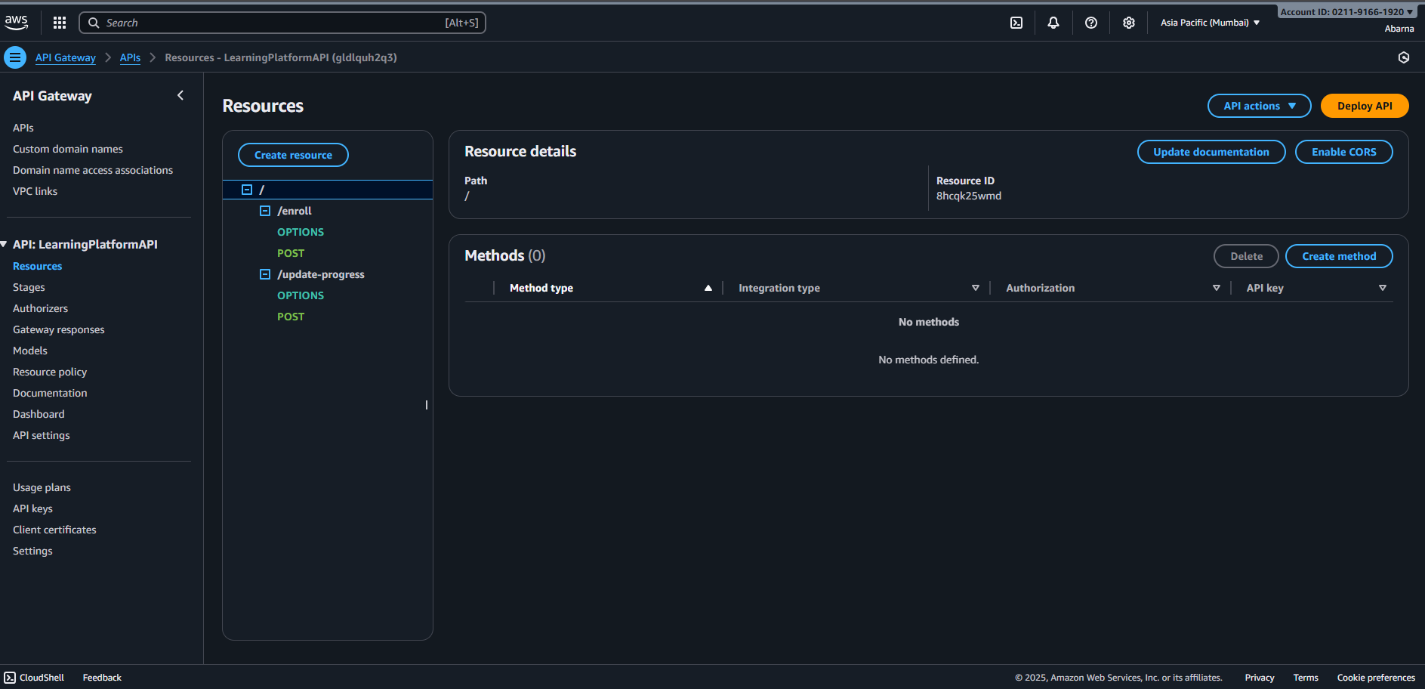
Create 2 methods:
POST /enroll → link to EnrollmentHandler LambdaFunction
POST /update-Progress → link to update-progress Lambda Function

Slide 18
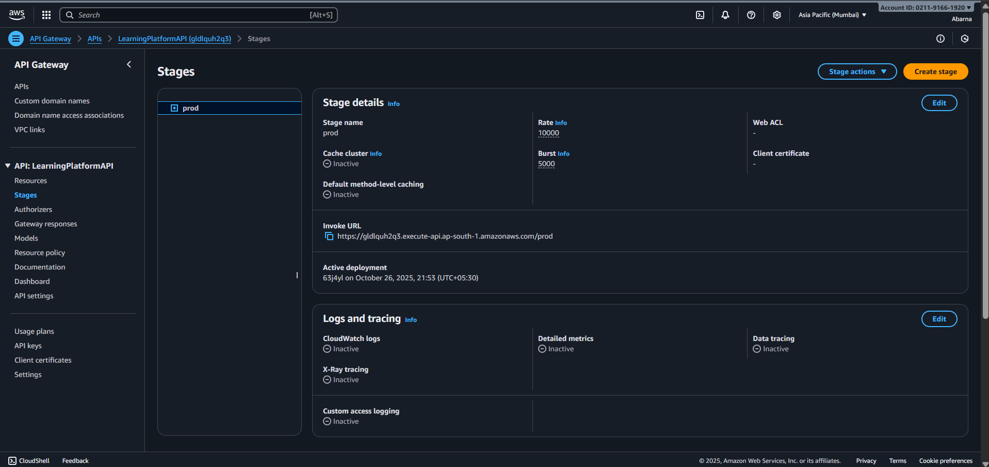
Enable CORS for both methods
Deploy the API → copy the Invoke URL
( https://gldlquh2q3.execute-api.ap-south-1.amazonaws.com/prod )

Slide 19
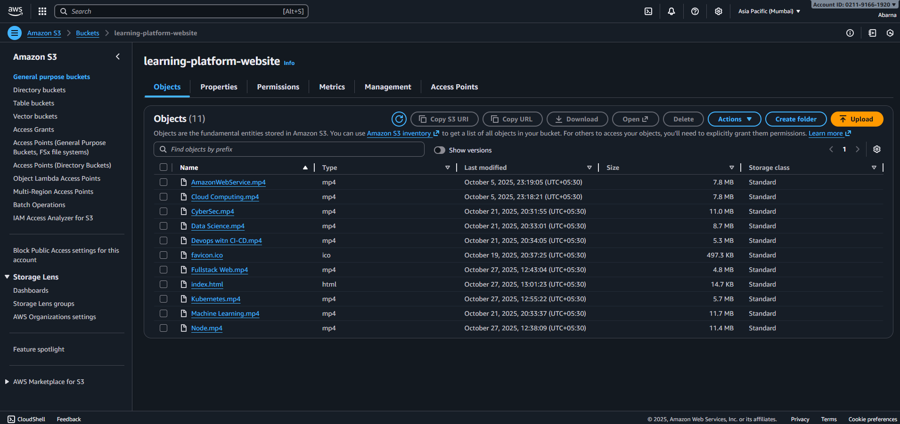
Step5 : S3 static website (frontend)
Amazon Console→ S3 → Create Bucket (learning-platform-website ) → upload “ index.html” file and mp4 files for watching the videos
Replace the API URL inside your HTML with your API Gateway invoke URL.
Enable Static Website Hosting

Slide 20
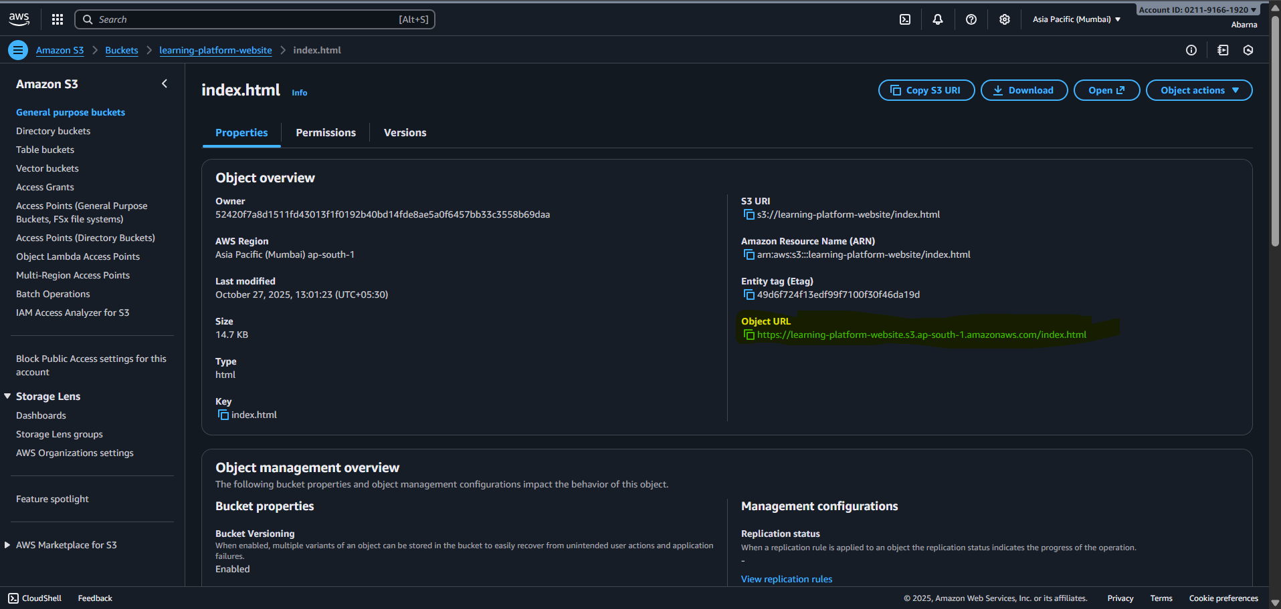

Refer frontend code : https://github.com/Abarna0504/Project-codes---Online-Learning-Platform.git [index (frontend).txt ]
copy the object URL and paste it in browser for output.

Slide 21
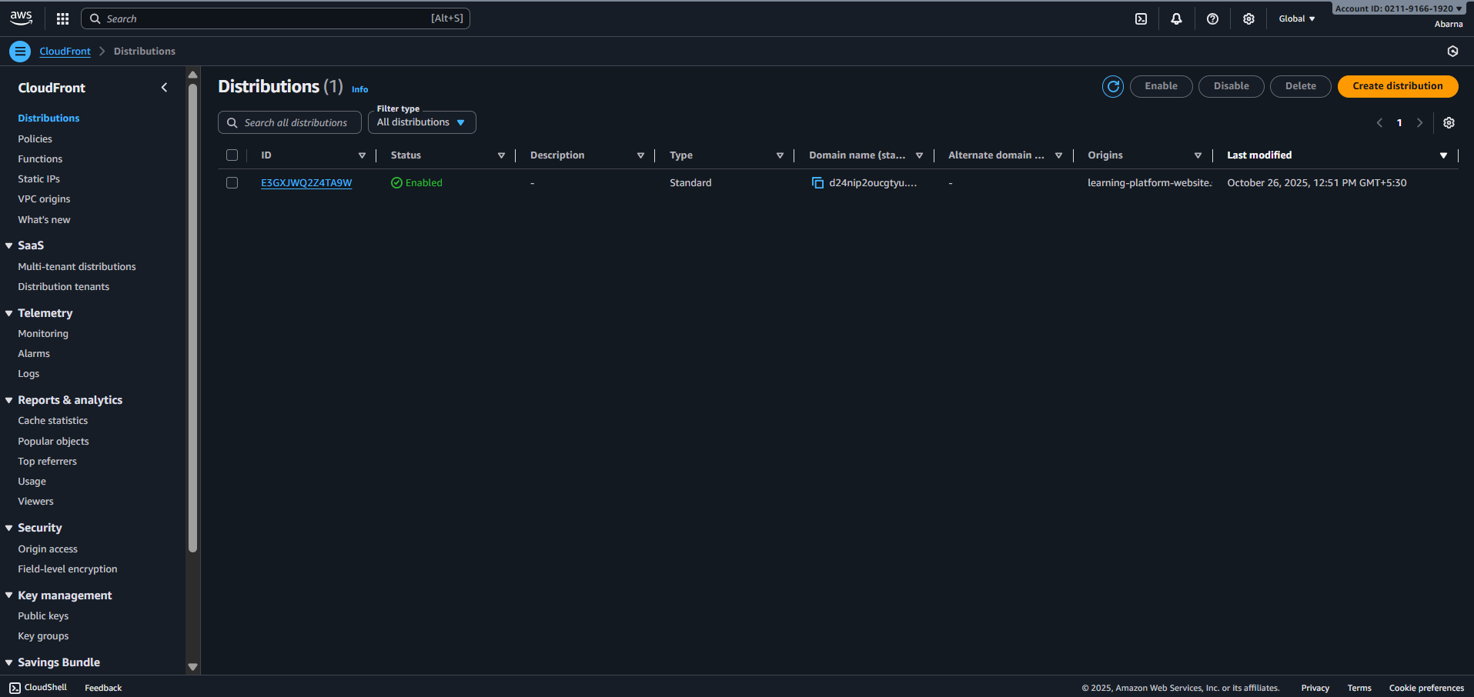
Step 6 : Distribute via CloudFront
Go to CloudFront → Create Distribution
Origin domain: select your S3 bucket (static website endpoint)
Enable HTTPS and caching for fast delivery
Once deployed, access your site via the CloudFront URL
(https://d24nip2oucgtyu.cloudfront.net )

Slide 22
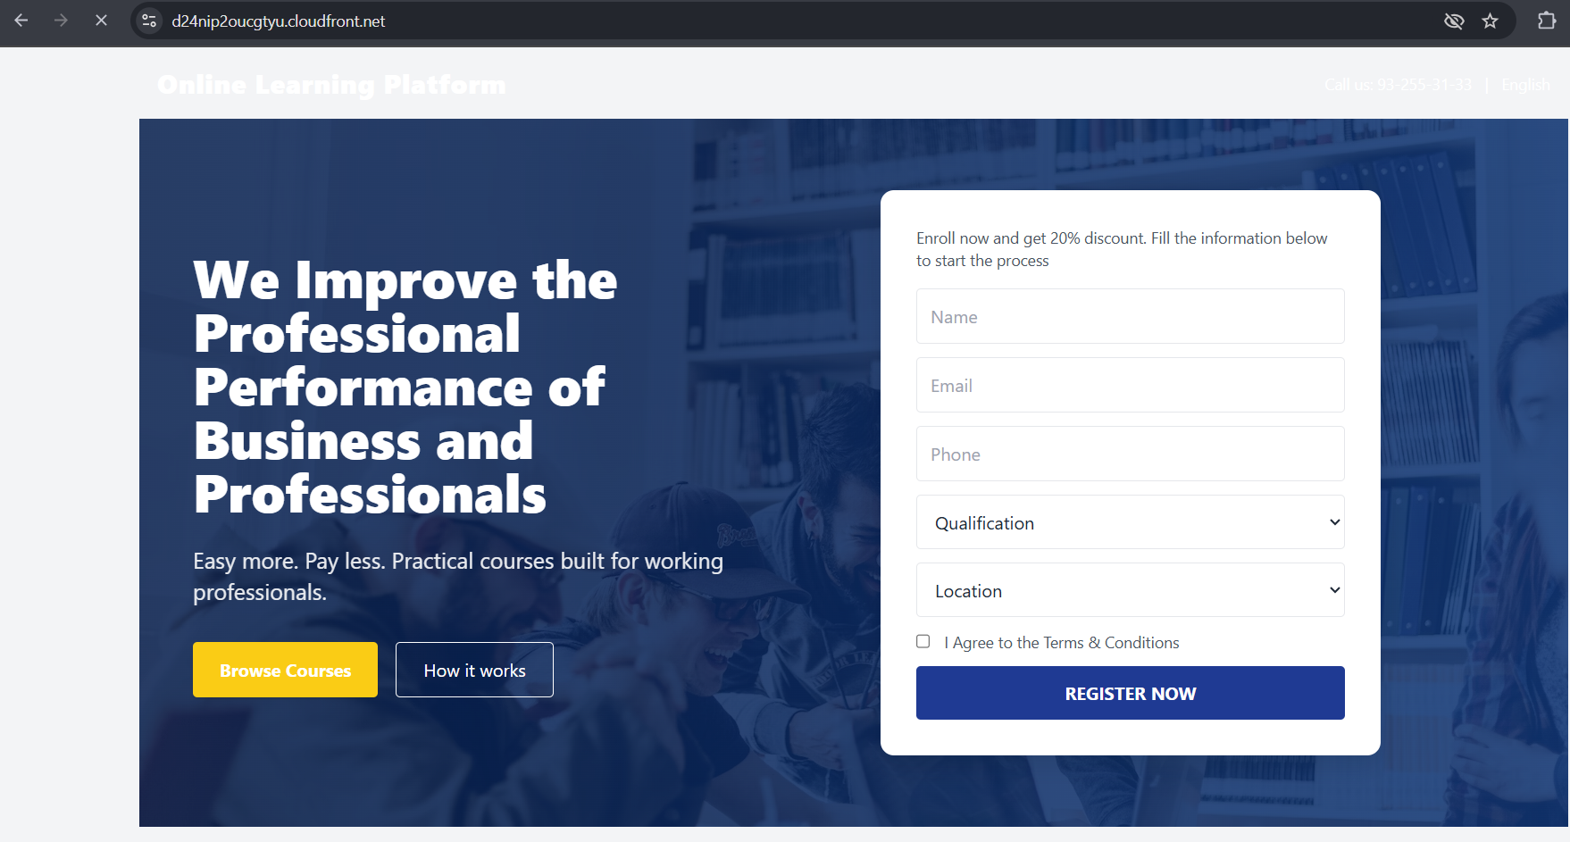
Step 7 : Test and Verify
Open CloudFront URL : (https://d24nip2oucgtyu.cloudfront.net )

Slide 23
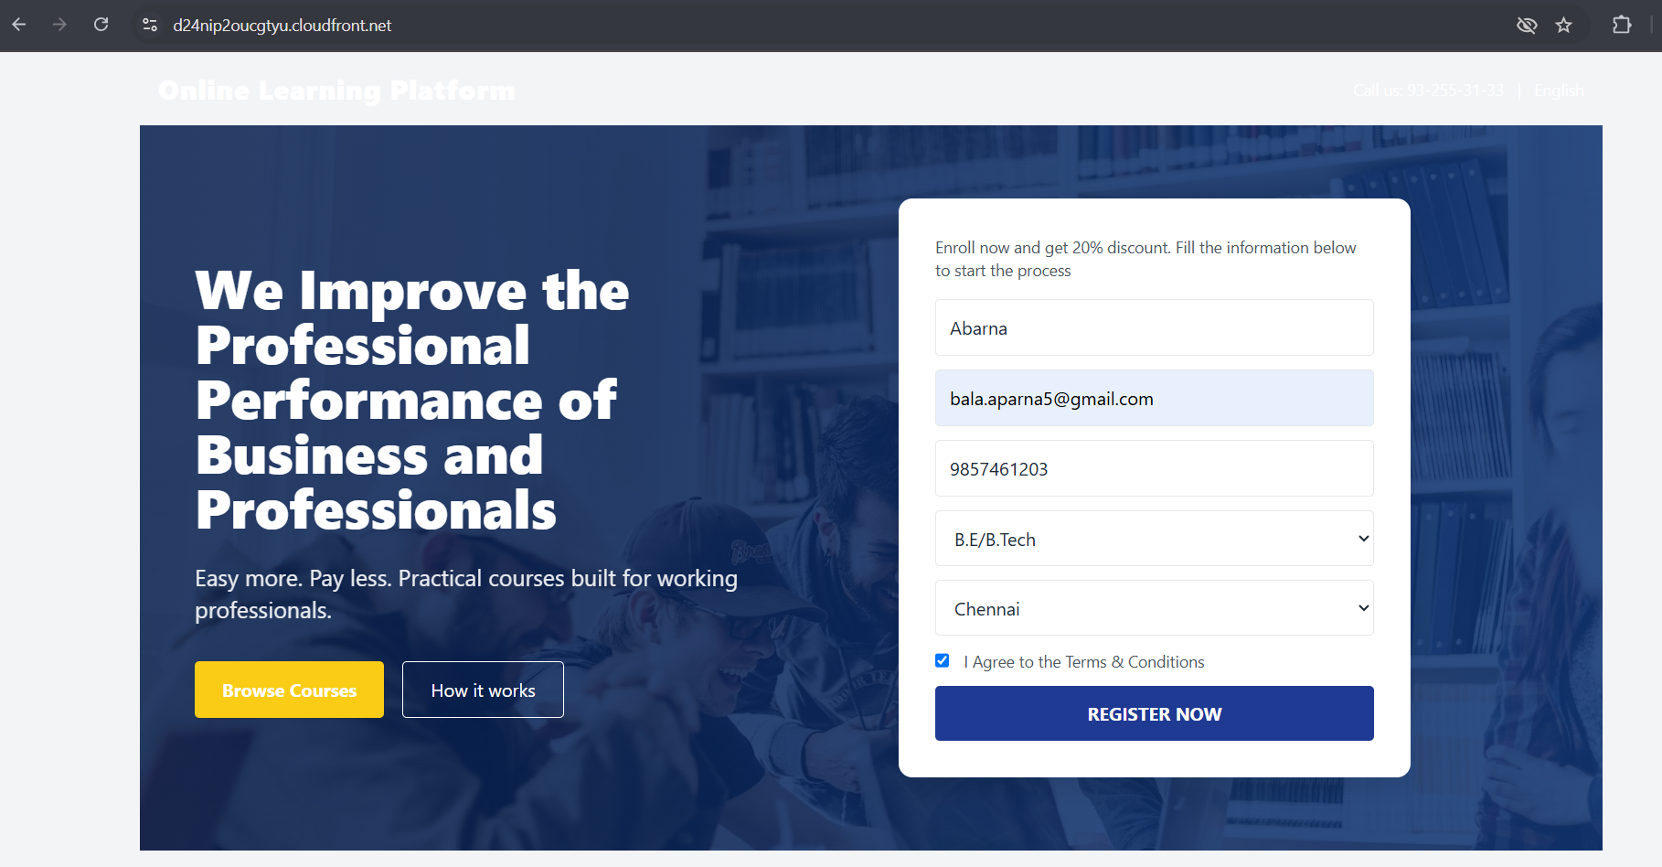
Fill enrollment form → Register Now
Enter your name, email, phone number, qualification, and location.
Click Register Now — this triggers the API Gateway → Lambda (Enroll) flow.

Slide 24
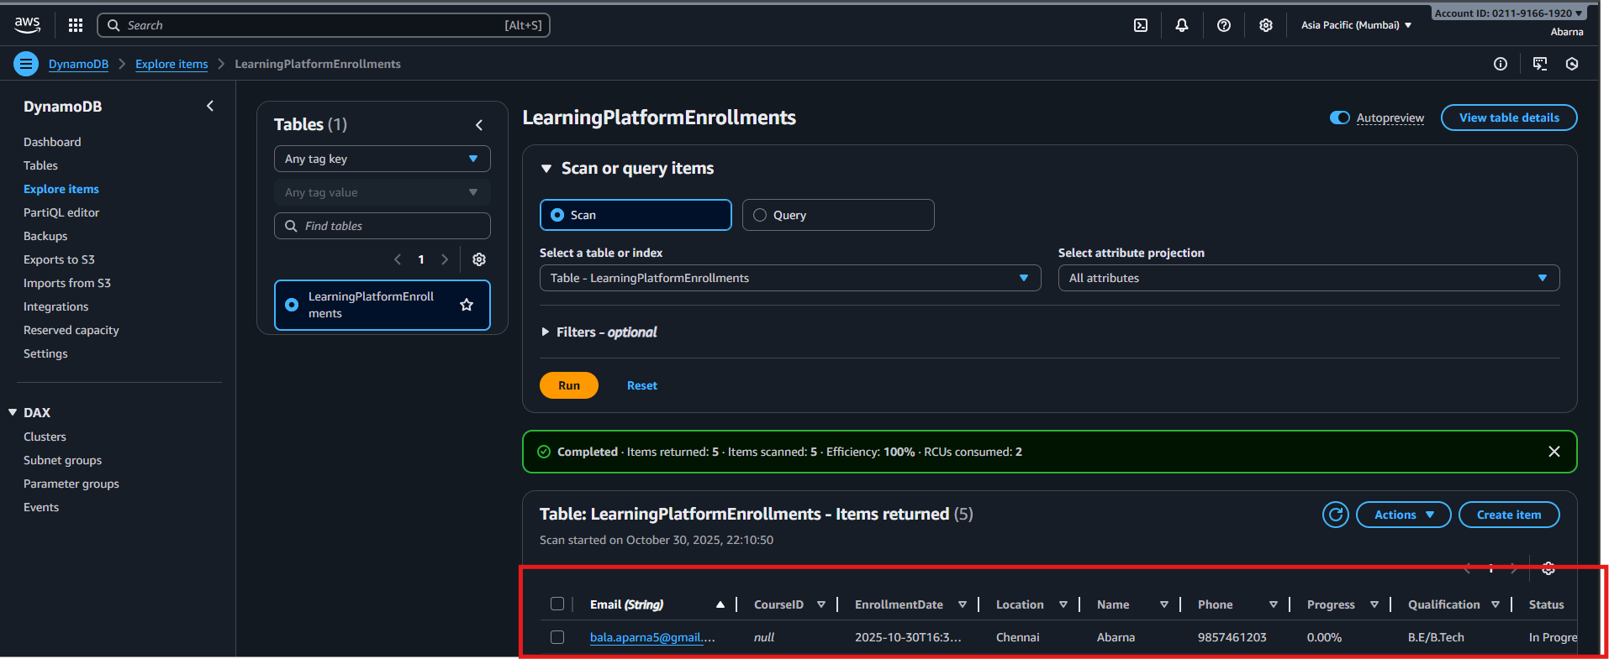
Check DynamoDB Entries
Open DynamoDB → LearningPlatformEnrollments → Explore Table Items
You’ll see a new record with:
Email, CourseID, EnrollmentDate, Location, Name, Phone, Progress, Qualification, Status

Slide 25
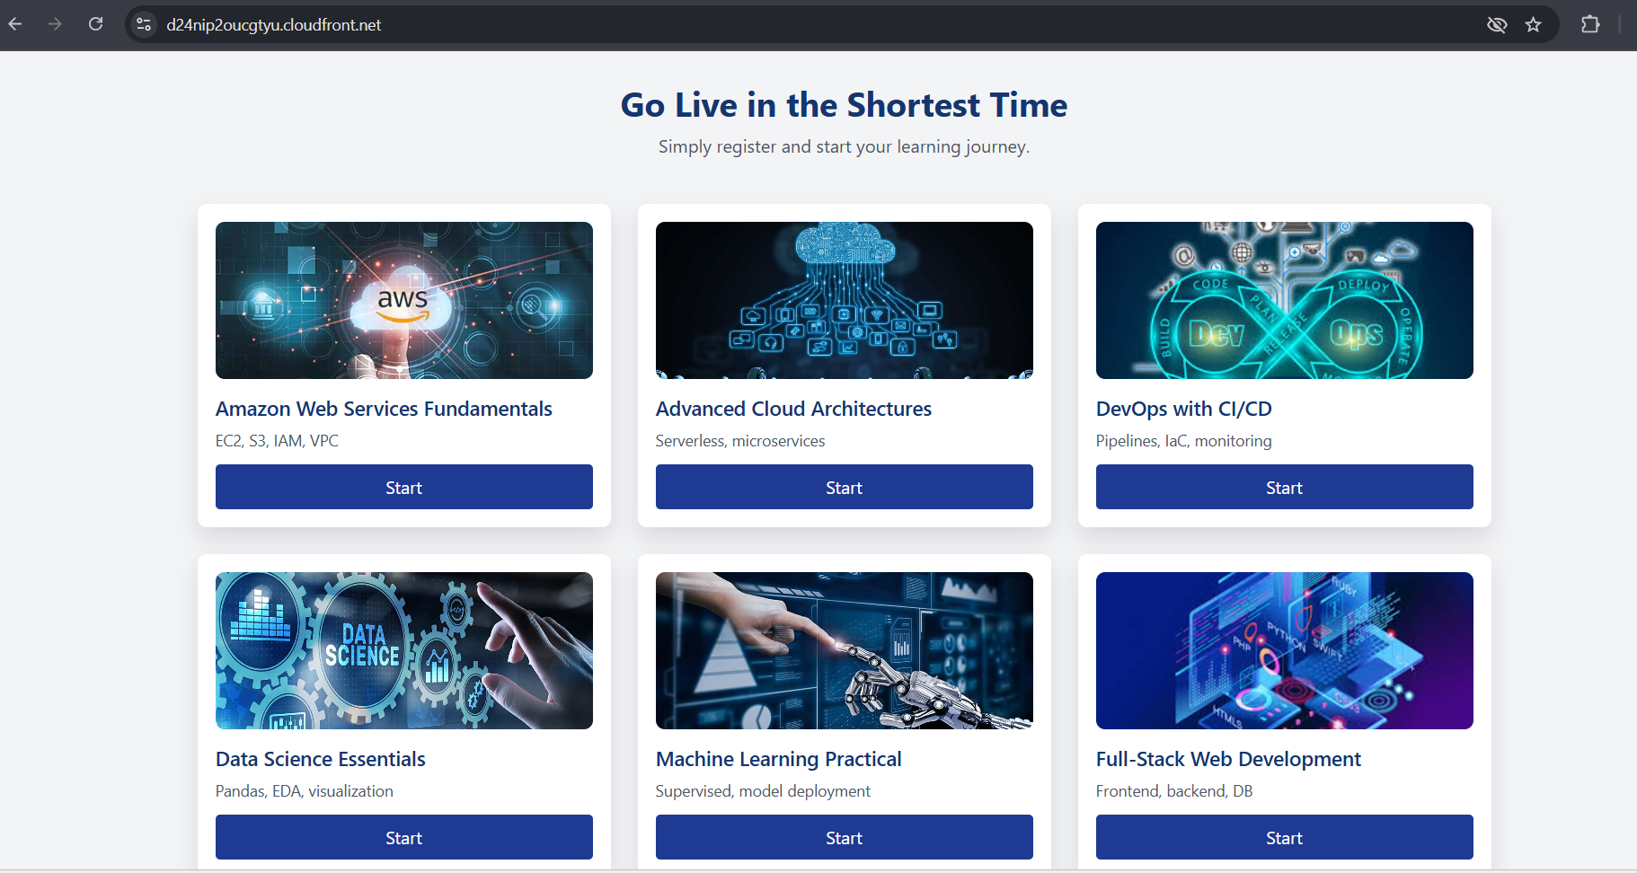
Choose your course (for example: AWS Basics, Data Science etc.) →From the course list, choose the course you enrolled in.

Slide 26
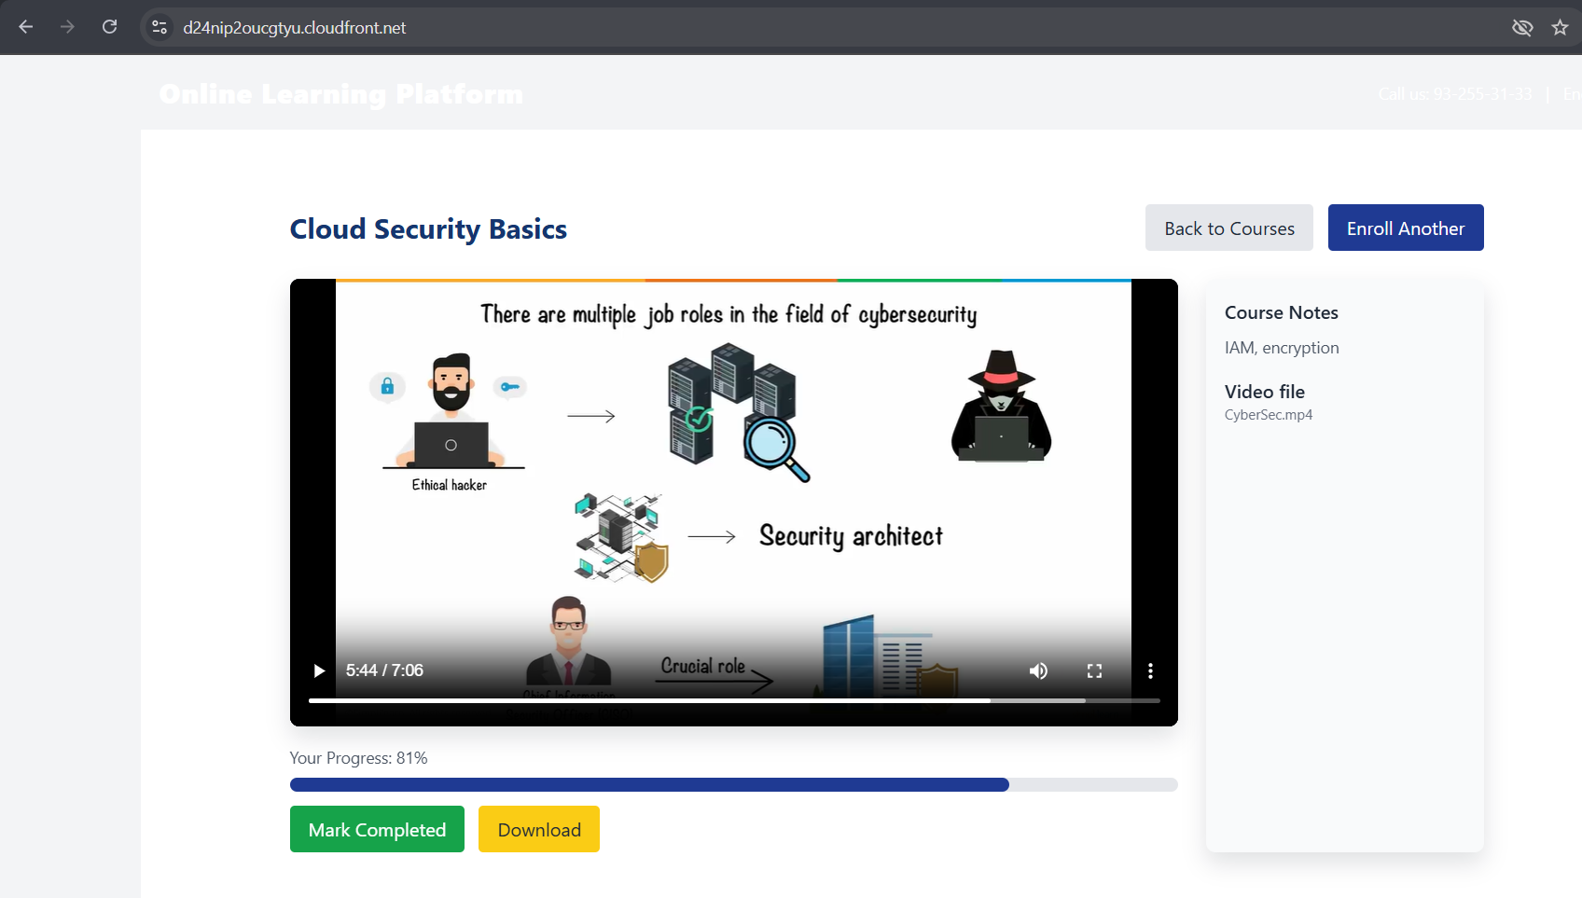
Select and Watch Course Videos
Videos are hosted on S3, streamed through the CloudFront distribution for fast playback.
As you watch or complete the video lessons, the frontend calls the Update Progress Lambda via API Gateway.

Slide 27
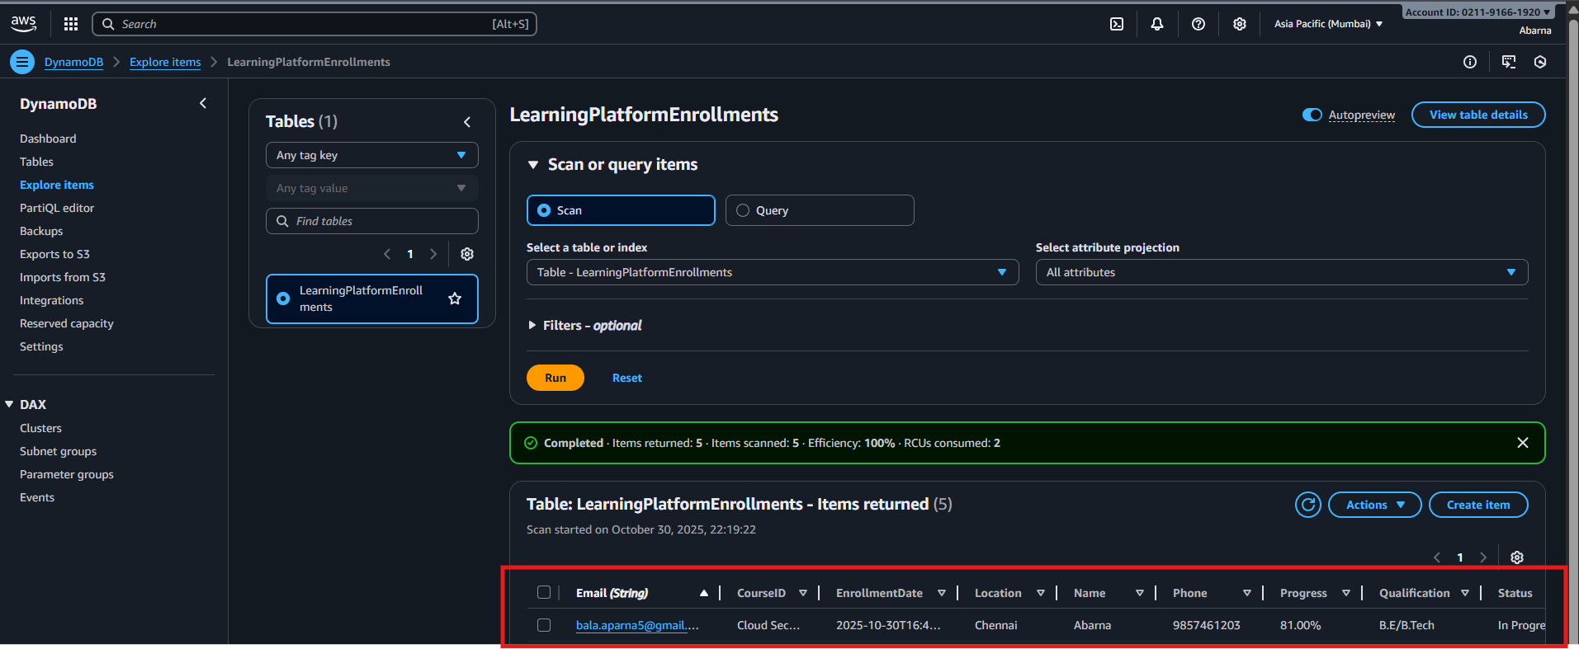
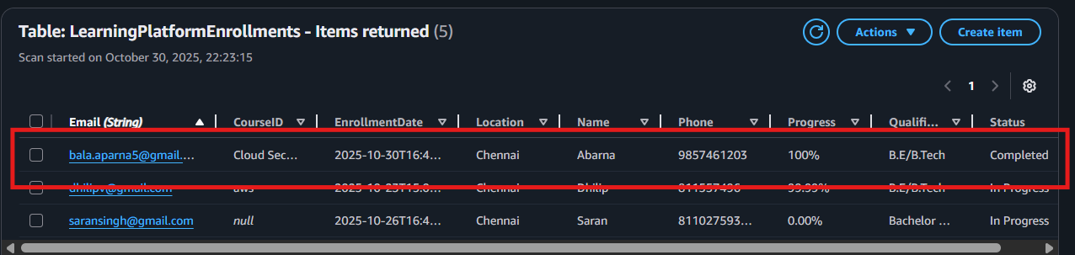
Track Progress Updates
Each time progress is updated, the UpdateProgress Lambda modifies your record in DynamoDB.
Example:
Progress → “50 %”, Status → “In Progress” Progress → “100 %”, Status → “Completed”

Slide 28
Advantages / Future Scope
Advantages
No server management
Auto-scalable
Cost-effective (pay per request)
High availability
Future Add-ons
Admin dashboard
User authentication (Cognito)
Payments integration (Razorpay)
AI course recommendations

Slide 29
Conclusion
The project successfully demonstrates how AWS Serverless Architecture can power a modern e-learning platform efficiently and at low cost.
By integrating services like Lambda, API Gateway, DynamoDB, S3, CloudFront, SES, and IAM, a complete end-to-end system was achieved without managing any servers.
The application ensures scalability, high availability, and security with minimal operational effort.
Students can enroll, learn, and track progress seamlessly, while all data and communication are automated in the cloud.
This project can be further enhanced by adding user authentication (Cognito), payment integration, and an admin dashboard for real-time analytics.
This project gave me hands-on experience in connecting multiple AWS services and understanding the power of serverless cloud solutions

Slide 30
References
AWS General Documentation
https://docs.aws.amazon.com
2. AWS Lambda Developer Guide
https://docs.aws.amazon.com/lambda/latest/dg/welcome.html
3. Amazon API Gateway Developer Guide https://docs.aws.amazon.com/apigateway/latest/developerguide/welcome.html
4. Amazon DynamoDB Developer Guide https://docs.aws.amazon.com/amazondynamodb/latest/developerguide/Introduction.html
5. Amazon S3 Developer Guide https://docs.aws.amazon.com/AmazonS3/latest/dev/Welcome.html
6. AWS CloudFront Documentation https://docs.aws.amazon.com/AmazonCloudFront/latest/DeveloperGuide/Introduction.html
7. AWS Identity and Access Management (IAM) https://docs.aws.amazon.com/IAM/latest/UserGuide/introduction.html

Slide 31
“Thank you for your time and attention.” “Questions?”

